Slide 1
APSDEU-14/NAEDEX-26: NESDIS Status Update
John Paquette
Physical Scientist, OSPO
NOAA Satellite & Information Service
October 2015
Notes:
Our Mission is to deliver accurate, timely, and reliable satellite observations and integrated products and to provide long-term stewardship for global environmental information in support of our Earth observation mission.
IMAGE: This imagery taken from the VIIRS instrument on NOAA/NASA Suomi NPP on August 3, 2015.

Slide 2
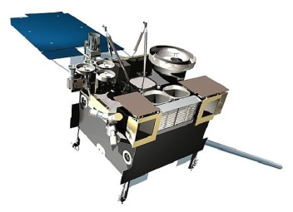
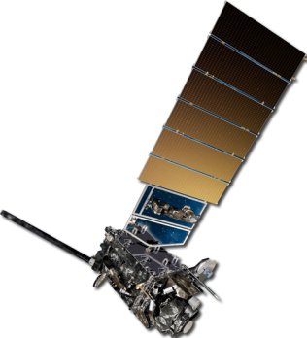
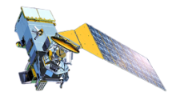
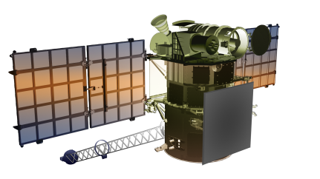
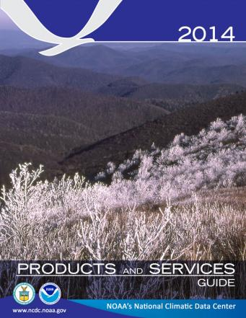
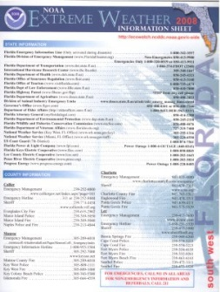
NESDIS Principal Activities
Currently Providing 24/7 On-Orbit Satellite Operations
Geostationary satellites (GOES)
Polar-orbiting satellites (POES)
Defense Meteorological Satellite Program (DMSP)
Jason-2 Altimetry Satellite
Suomi National Polar-orbiting Partnership (S-NPP)
DSCOVR (Solar Wind Continuity)
Acquiring Next Generation Satellites
Jason-3 Altimetry Satellite
COSMIC-2 Radio Occultation
GOES–R Satellite Series
Joint Polar Satellite System (JPSS)
Providing Long Term Data Stewardship
Conducting Research and Developing Operations
POES
GOES
JPSS
GOES-R
DSCOVR
NEIO

Slide 3
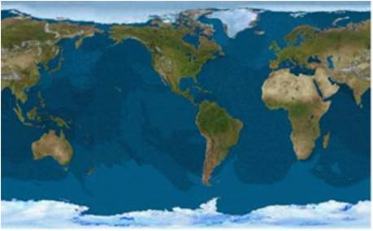
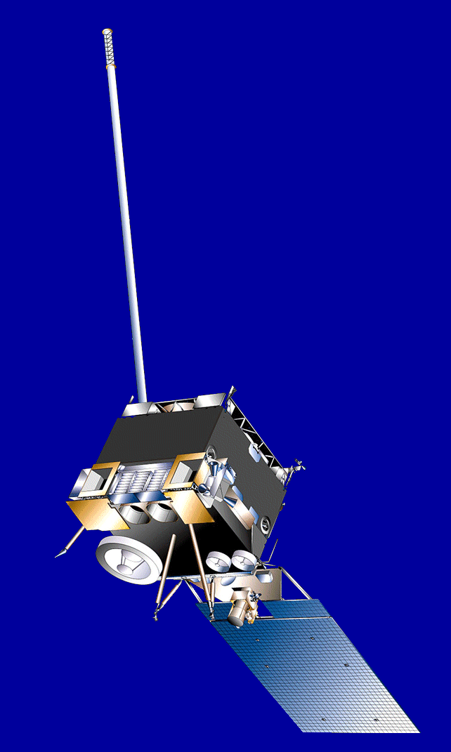
Current Geostationary Observations: GOES-NOP
GOES-15 | GOES-14 | GOES-13
Launched: 3/2010 Located: 135°W GOES-WEST | Launched: 6/2009 Located: 105°W On-Orbit Storage | Launched: 5/2006 Located: 75°W GOES-EAST
GOES-15
@ 135W
GOES-13
75° West
GOES-14
@105W

Slide 4
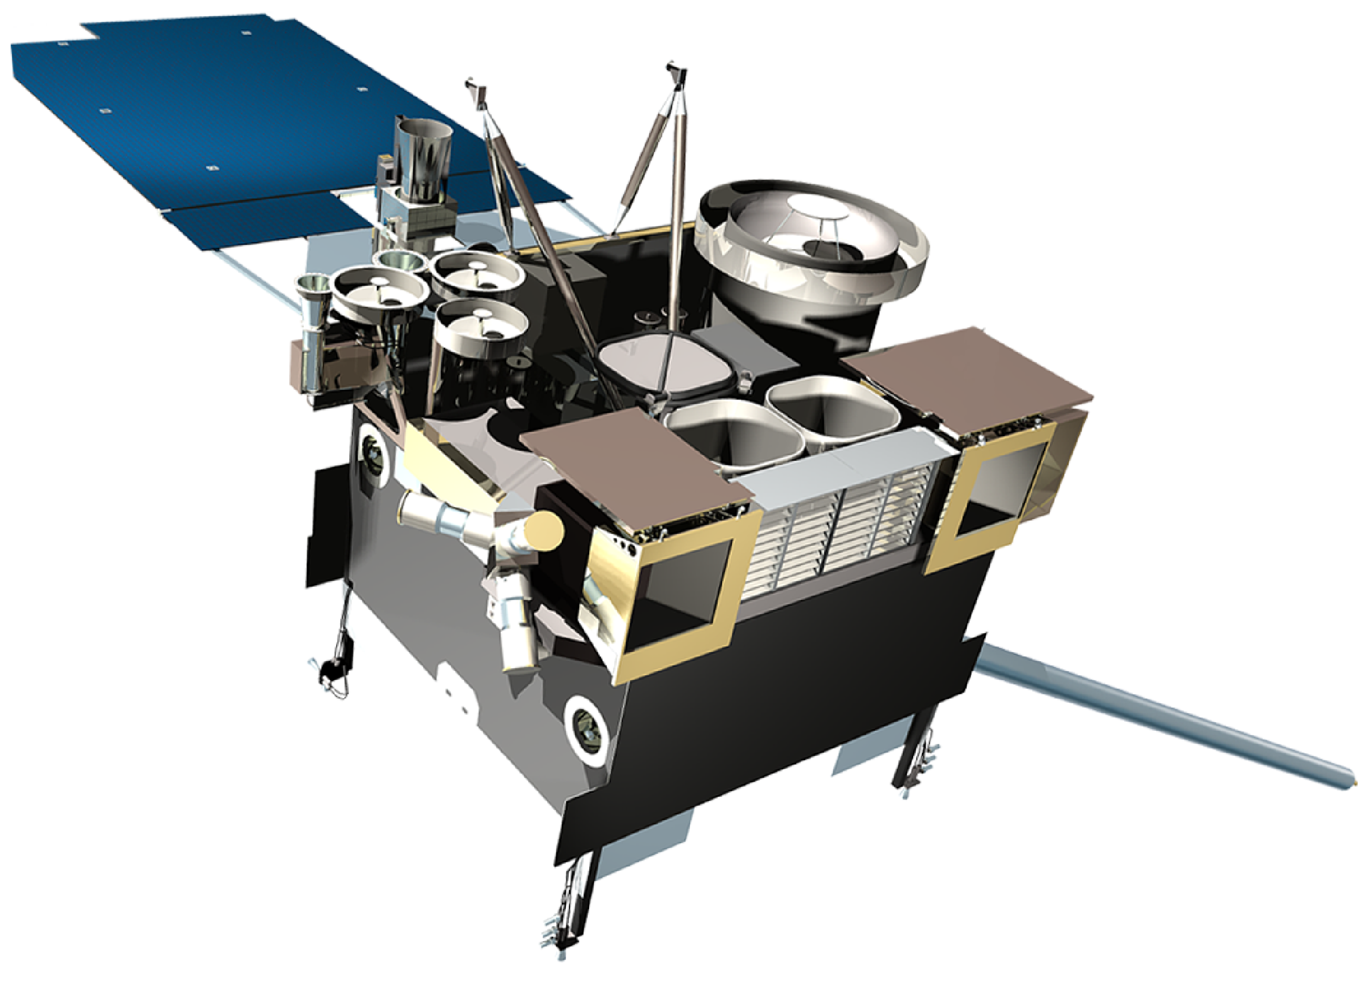
Current Geostationary Observations: GOES-13 (East)
Issue #1:
Sounder filter wheel anomaly. Sounder frame sync losses.
Impact:
Sounder pixel dropouts (minimal).
Issue #2:
CRS capacitor short.
Impact:
XRS X-ray measurements can potentially invert unexpectedly.
Issue #3:
SXI detector damage due to flare.
Impact:
Nine rows currently affected out of 512 total.

Slide 5
Current Geostationary Observations: GOES-14 (Standby)
No Spacecraft or Instrument Issues

Slide 6
Current Geostationary Observations: GOES-15 (West)
Issue #1:
Star Tracker1 (ST1) and Star Tracker2 (ST2) failure. Operations with ST3 only.
Impact:
Degraded INR performance.
Issue #2:
Sounder temperature control blanket is raised. To maintain patch temperature control, a yaw flip at Equinox to keep Sun angle below cooler plane.
Impact:
1 hour data outage and degraded products during each yaw flip maneuver and 28 hours of INR (Image Navigation & Registration) recovery period.

Slide 7
Current Geostationary Observations: Instrument Status GOES-NOP
Payload Instrument | GOES-13 (East) Launch: May 06 Activation: Apr 10 | GOES-14 (Standby) Launch: Jun 09 Activation: TBD | GOES-15 (West ) Launch: Mar 10 Activation: Dec 11
Imager | G | G | G
Sounder | G | G | Y
Energetic Particle Sensor (EPS) | G | G | G
Magnetometers | G | G | G
High Energy Proton and Alpha Detector (HEPAD) |  | G | G
X-Ray Sensor (XRS) | Y | G | G
Solar X-Ray Imager (SXI) | Y | G | S/C
Spacecraft Subsystems
Telemetry, Command & Control | G | G | G
Attitude and Orbit Control | G | G | G
Inclination Control | G | G | G
Propulsion | G | G | G
Mechanisms | G | G | G
Electrical Power | G | G | G
Thermal Control | G | G | G
Communications Payloads | G | G | G
Key
Operational
Operational with limitations
Non-operational
G
Y
R

Slide 8
Current Geostationary Observations: Product Status GOES-NOP
 | GOES-13 | GOES-15
Launch Date | May 2006 | March 2010
Operational Date | April 2010 | December 2011
Mission Data Category | GOES-East | GOES-West
Product Areas
Imagery | G | G
Radiances | G | G
RadBud/Emissivity | G | G
Soundings | G | G
Winds | G | G
Sea Surface Temp | G | G
Precipitation | G | G
Volcanic Ash | G | G
Tropical Products | G | G
Ozone | N/A | N/A
Fire and Smoke | G | G
Snow and Ice | G | G
Vegetation | N/A | N/A
Broadcast Services | G | G
Operational GG | G | Future S-NPP products
Operational with Issues During Reporting Period | Y | Operational with Degradation | O
Non-Operational | RR | Not Applicable | N/A

Slide 9
Geostationary Observations: Flyout Schedule

Slide 10
Current Polar-Orbiting Observations: POES and Suomi NPP
NOAA-15 | NOAA-18 | NOAA-19 | Suomi NPP
Launched: 12/1998 Secondary AM orbit | Launched: 8/2005 Secondary PM orbit | Launched: 6/2009 Secondary PM orbit | Launched: 10/2011 Primary PM orbit

Slide 11
Current Polar-Orbiting Observations: Instrument Status
Spacecraft Subsystems | METOP-A | METOP-B | NOAA-19 | NOAA-18 | NOAA-15
Launch Date | Oct 2006 | Sept 2012 | Feb 2009 | May 2005 | May 1998
Operational Date | May 2007 | April 2013 | Jun 2009 | Aug 2005 | Dec 1998
Mission Data Category | Secondary (AM) | Primary (AM) | Secondary (PM) | Secondary (PM) | Secondary (AM)
Payload Instruments
AVHRR | G | G | G | G | Y(19)
HIRS | G | Y(32) | O (31) | R (3) | R (5)
AMSU-A1 | O (30) | G | G | G | Y(20)
AMSU-A2 | G | G | G | G
AMSU-B | N/A |  | N/A | N/A | R (11)
MHS | G | G | Y (6) | G | N/A
SEM | G | G | G | G | G
SBUV | N/A |  | S/C (9) | R(27) | N/A
Spacecraft Subsystems
Telemetry, Command & Control | G | G | G | G | G
ADACS | G | G | G | G | O (10)
EPS | G | G | G | G | G
Thermal Control | G | G | G | G | Y(21)
Communications | Y (1) | G | G | G | Y(22)
APT/LRPT | R (2) | G | G | G | G
DCS | N/A | N/A | N/A | G | G
ADCS | G | O(29) | Y(34) | N/A | N/A
SAR: SARR & SARP | G | Y(35) | G | G | Y(23)

Slide 12
Definition of Status Colors
Definition of Status Colors
Operational | G | Spacecraft Issue but No User Impact | S/C
Operational with Limitation | Y | Operational with Degradation | O
Non-Operational | R | Not Applicable | N/A

Slide 13
Current Polar-Orbiting Observations: Product Status of Operational Satellites
 | METOP-B | NOAA-19 | S-NPP*
Launch Date | Sept 2012 | Feb 2009 | Oct 2011
Operational Date | April 2013 | Jun 2009 | Sept 2013 (NDE)
Mission Data Category | Primary (AM) | Secondary (PM) | Primary (PM)
Product Areas
Imagery | G | G | G
Radiances | G | G | G (CrIS/ATMS)
RadBud/Emissivity | G | G | G (Emissivity)
Soundings | G | G | G (CrIS/ATMS Moist and Temp Profiles)
Winds | G | G | G (VIIRS PW)
Sea Surface Temp | G | G | G (VIIRS SST)
Precipitation | G | G | G (MIRS RR+TPW)
Volcanic Ash | G | G | FY-16
Tropical Products | G | G | G (NTCP)
Ozone | G | G | G (OMPS TC/Profile + CrIS Ozone)
Fire and Smoke | G | G | G(Active fires and AOT)
Snow and Ice | G | G | G (Binary Snow Cover)
Vegetation | G | G | G (VIIRS Green Vegetation Fraction)
Broadcast Services | G | G | G
Operational GG | G | Future S-NPP products
Operational with Issues During Reporting Period | Y | Operational with Degradation | O
Non-Operational | RR | Not Applicable | N/A
*NPP Products includes only those deemed operational since NDE handover Sept 26, 2013

Slide 14
Current Polar-Orbiting Observations: Product Status of Backup Satellites
 | METOP-A | NOAA-18 | NOAA-15
Launch Date | Oct 2006 | May 2005 | May 1998
Operational Date | May 2007 | Aug 2005 | Dec 1998
Mission Data Category | Secondary (AM) | Secondary (PM) | Secondary (AM)
Product Areas
Imagery | G | G | G
Radiances | G | Y | Y
Radiation Budget/Emissivity | G | G | G
Soundings | Y | R | R
Winds | G | G | G
Sea Surface Temp | G | G | R
Precipitation | G | G | Y (TPW Only)
Volcanic Ash | G | G | N/A
Tropical Products | G | G | G
Ozone | G | Y | R
Fire and Smoke | G | G | G
Snow and Ice | G | G | G
Vegetation | G | G | R
Broadcast Services | Y*¹ | G | G
Operational GG | G | Future S-NPP products
Operational with Issues During Reporting Period | Y | Operational with Degradation | O
Non-Operatioal | RR | Not Applicable | N/A
*²Metop-A AHRPT does not support full global coverage due to earlier failure of part of the AHRPT system

Slide 15
Current Polar-Orbiting Observations: Status of Suomi NPP
S-NPP Space System is GREEN
Spacecraft Subsystem | Status
TLM, Command & Control | G
ADCS | G
EPS | G
Thermal Control | G
Communications | G
CDP | G
SCC | G
GPS | G
1553 | G
1394 | G
Spacecraft | S-NPP
Launch Date | Oct 28, 2011
Mission Category | LTAN 1330 (PM)
Payload Instruments | Status
ATMS | G
CERES | G
CrIS | G
OMPS – Nadir | G
OMPS – Limb | G
VIIRS | G
Operational (or capable of)
Operational with limitations (or standby)
Operational with degraded performance
Not functional

Slide 16
Current Polar-Orbiting Observations: Suomi NPP NDE Operational Products
Application Short Name | Application Name | Product Name | Format | Satellite
ACSPO SST | Advanced Clear Sky Processor for Oceans (NDE) - SST | SST, Clear Sky Mask | netCDF | SNPP
AOT | Aerosol Optical Thickness | VIIRS Aerosol Optical Thickness (NDE) | BUFR | SNPP
ATMS-SDR | ATMS SDR radiances | ATMS SDR radiances 22 channels (NDE) | BUFR | SNPP
CRIS-SDR-399 | CrIS SDR radiances 399 | CrIS IR sounder SDR radiances 399 channels for NWP data assimilation (NDE) | BUFR | SNPP
CRIS-SDR-1305 | CrIS SDR radiances 1305 | CrIS IR sounder SDR radiances 1305 channels for NWP data assimilation (NDE) | BUFR | SNPP
GVF | GVF | Green Vegetation Fraction – 7 day product | Grib2 | SNPP
NUCAPS Level 2 | NOAA Unique CrIS ATMS product System Level 2 | CrIS/ATMS Atmospheric Temp Profile CrIS/ATMS Atmospheric Moisture Profile | netCDF | SNPP
NTCP | Tropical Cyclone Products | ATMS Microwave Tropical Cyclone Product | ATCF Ascii | SNPP
MIRS ATMS | Microwave Integrated Retrieval System (NDE) - ATMS | MIRS ATMS image products MIRS ATMS SND products | netCDF | SNPP
OMPS-NP | OMPS nadir profile | Ozone nadir profile (NDE) | BUFR | SNPP
OMPS-TC | OMPS total column | Ozone total column (NDE) | BUFR | SNPP
VIIRS-EDR | VIIRS EDR | VIIRS EDR (NDE) | netCDF | SNPP
VIIRS-SDR | VIIRS SDR | VIIRS SDR (NDE) | netCDF | SNPP
VIIRS Binary Snow Cover | VIIRS Binary Snow Cover | VIIRS Binary Snow Map | netCDF | SNPP
VPW | VIIRS Polar Winds | VIIRS Polar Winds | BUFR netCDF | SNPP
Upcoming Operational Products (SPSRB schedule)
Vegetation Health (Aug), GCOM → NDE 1.0 (Sep)

Slide 17
Current Polar-Orbiting Observations: Suomi NPP Users
External Users | Product Types
NWS-AWIPS | NUP – VIIRS
NWSTG | NUP – ATMS /CrIS (moved to NCO)
NCEP-NCO | NUP – ATMS/CrIS/OMPS
NCEP-EMC | NUP – VIIRS
EUMETSAT | NUP – ATMS/CrIS/VIIRS
CMC | NUP – ATMS/CrIS/OMPS/VIIRS
JMA | NUP – ATMS/CrIS/OMPS
NASA-GPM | xDR – ATMS (pass-thru)
NASA-JPL | NUP - VIIRS
India-NCMWRF | NUP – ATMS/CrIS
NEP-IDP | NUP – VIIRS/ATMS-MiRS
STAR-CIRA | xDR – VIIRS (pass-thru)
STAR | NUP – ATMS/CrIS/VIIRS
NOAA-AOML | NUP – VIIRS
CLASS | NUP – VIIRS/ATMS/CrIS
*JTWC | ATMS (derived)
*NCEI | ACSPO – SST
Internal Users | Product Type
VIIRSDIST | NUPS – VIIRS
SFS MiRS | NUP – ATMS xDR – ATMs (pass-thru)
SFS NIC-IMS | xDR – VIIRS (pass-thru) NUP – ATMS
NIC | xDR – VIIRS (pass-thru) NUP – ATMS
GCOM-GPDS | xDR – GCOM RDR (pass-thru)
Coast Watch | NUP – VIIRS
NUCAPS | NUP – ATMS/CrIS
TOAST | NUP – ATMS/ CrIS/OMPS
Okeanos | xDR – VIIRS (pass-thru)
Blended SST | NUP - VIIRS
DAPE | NUP – ATMS/CrIS/VIIRS
Prod Mon | NUP – ATMS/CrIS/VIIRS
DDS-Legacy | Ancillary
* New Users
Note – NWSTG serviced moved to NWS/NCEP NCO

Slide 18
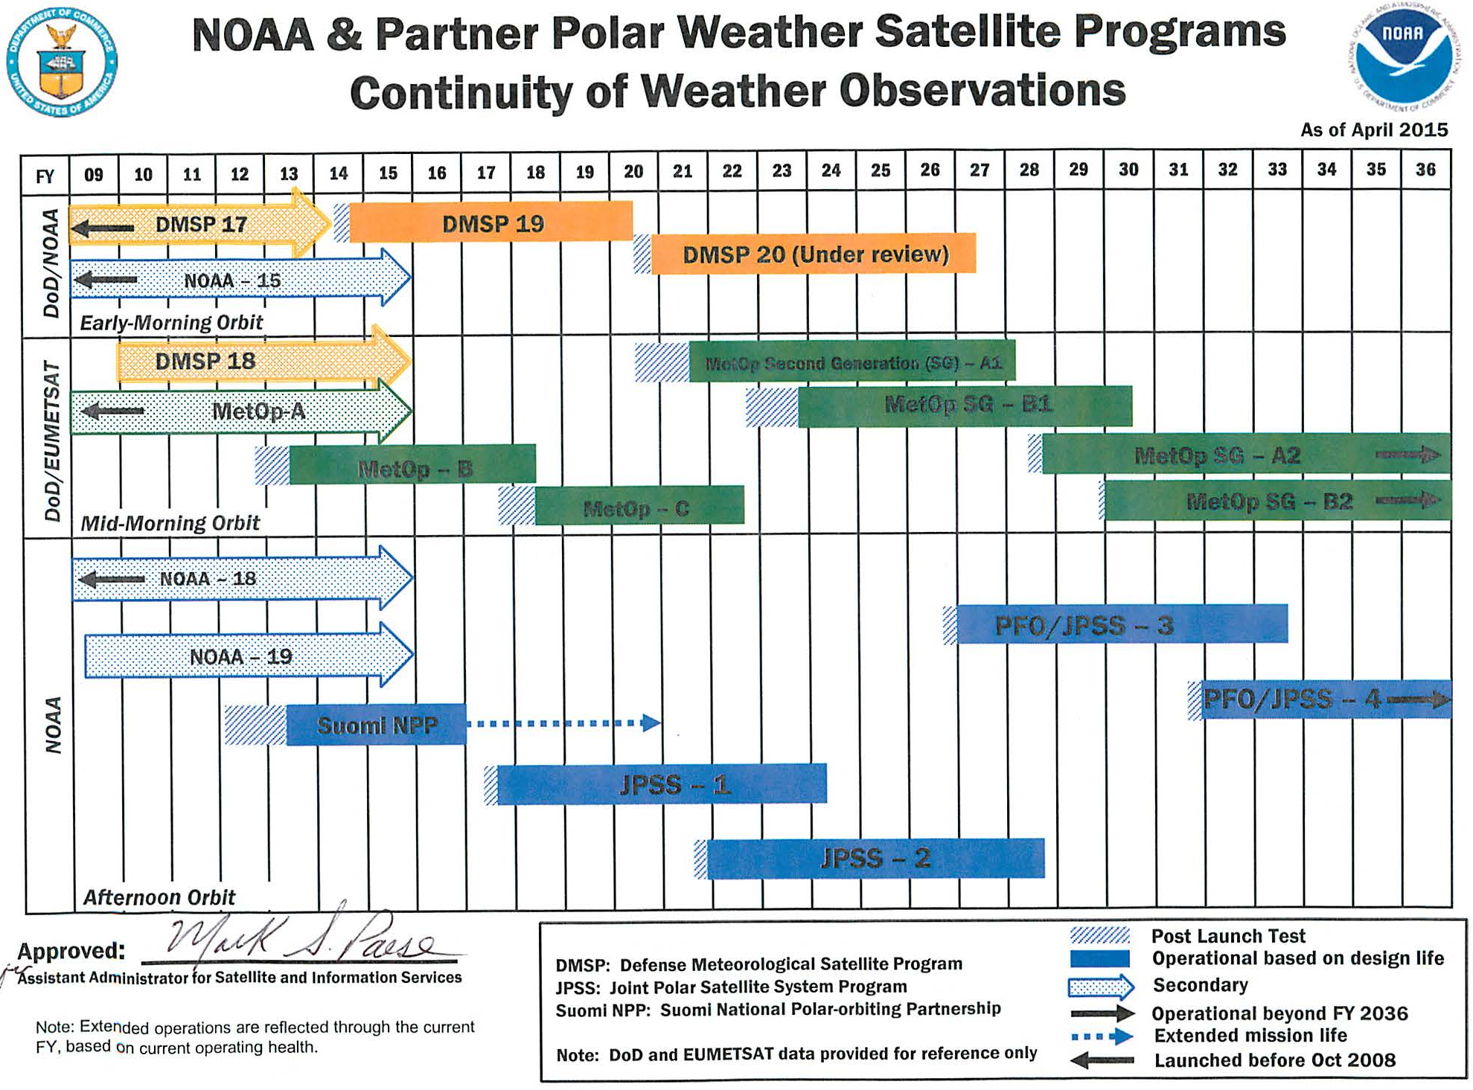
Polar-Orbiting Observations: Flyout Schedule

Slide 19
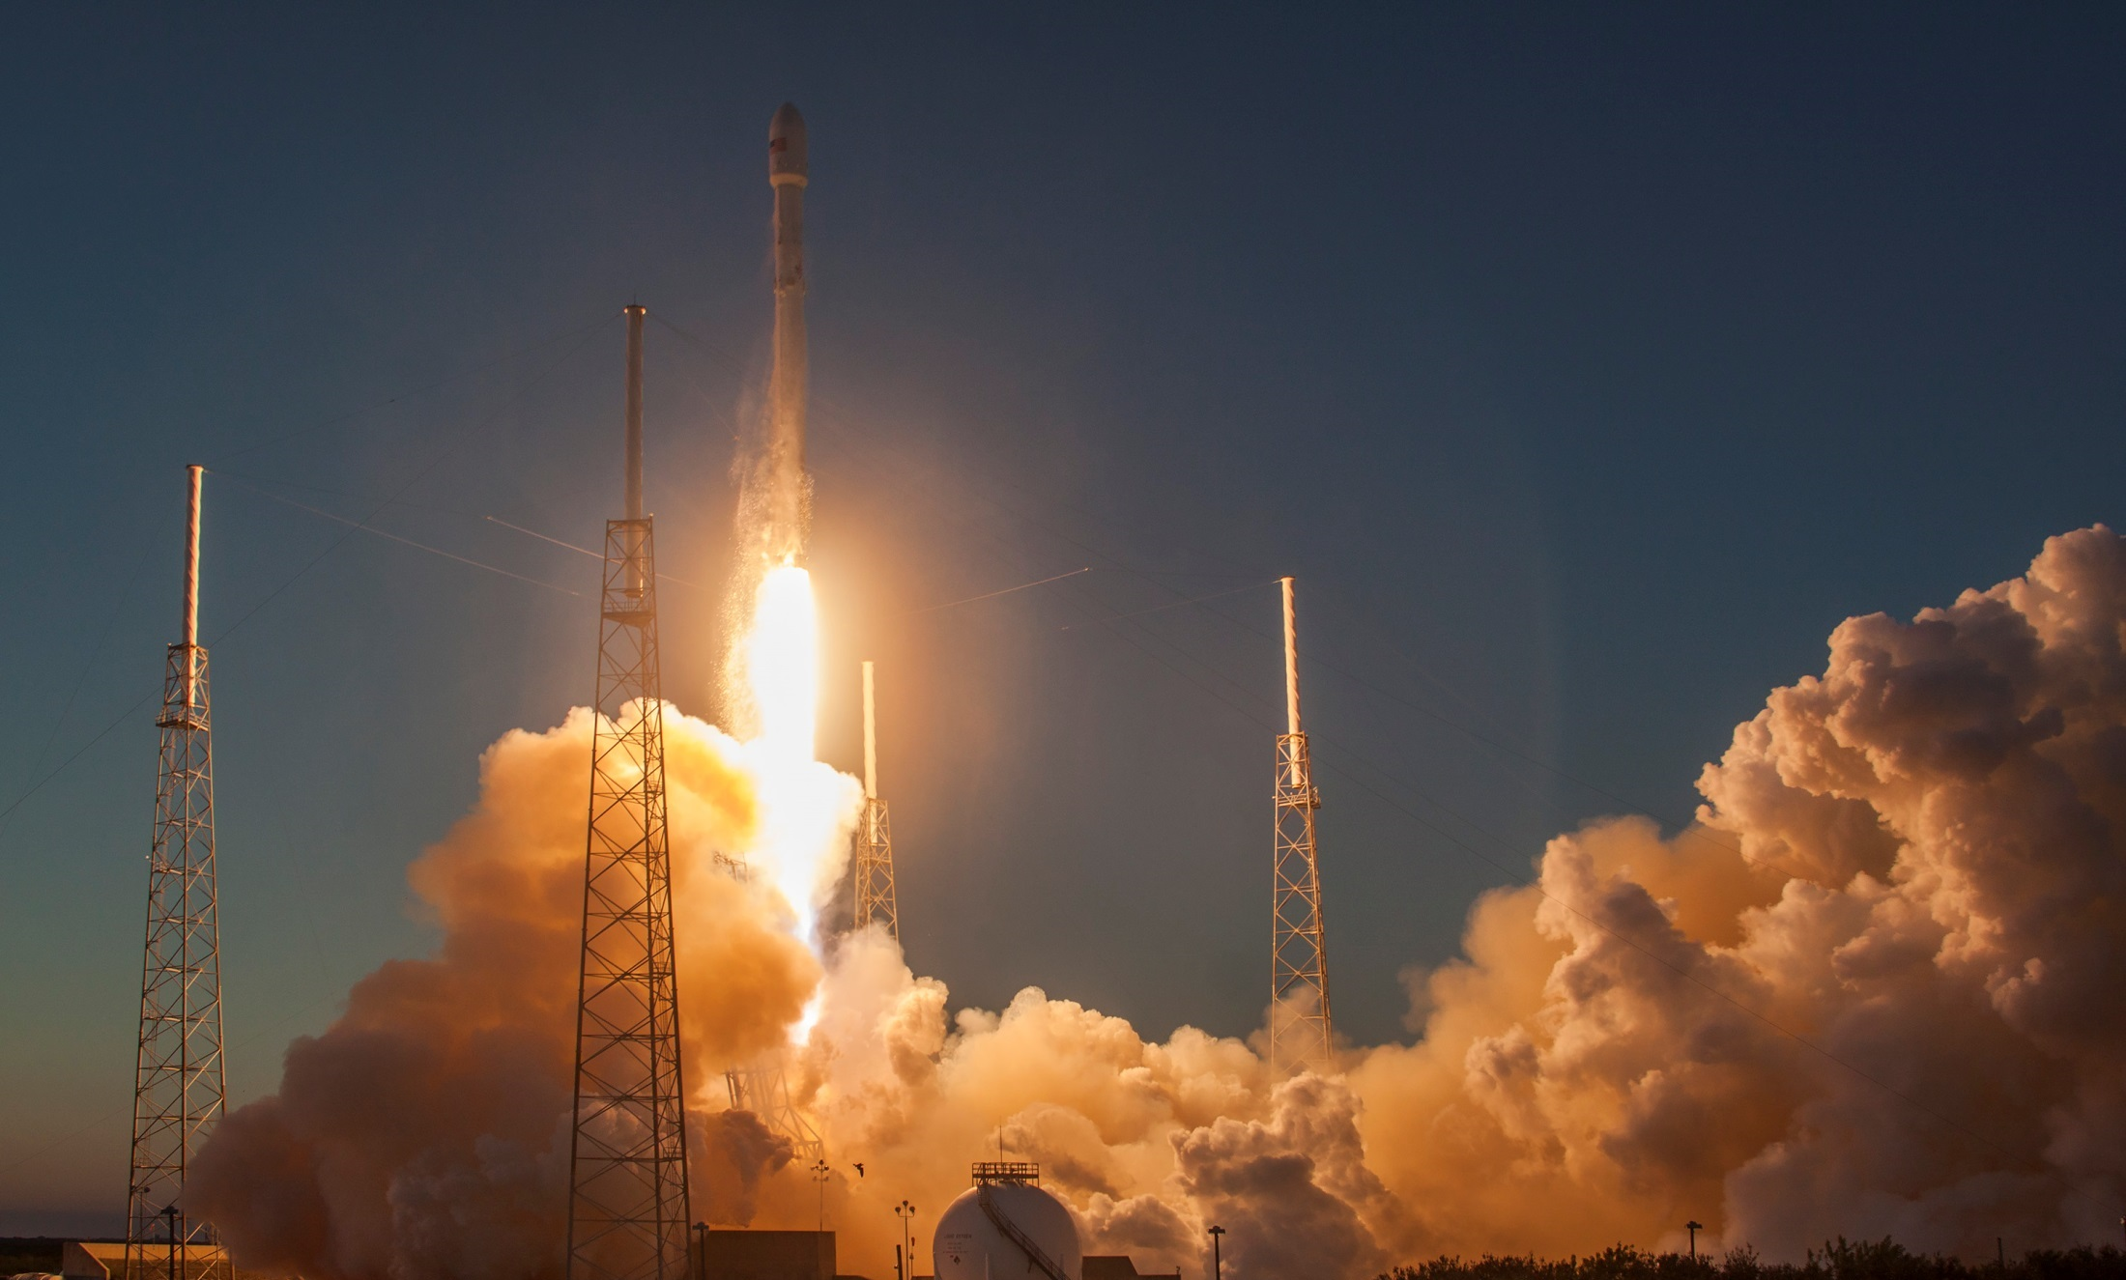
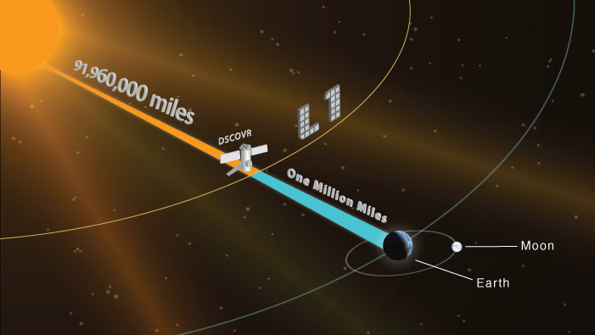
Current Space Weather Observations: DSCOVR
Launched 11 February 2015, at L1 on 8 June
Should be operational in October 2015
Credit: SpaceX
Notes:
For NOAA, space weather observations are a NESDIS responsibility while space weather forecasts and warnings are handled by the National Weather Service’s Space Weather Prediction Center.
We’re excited about space weather observations. DSCOVR, a joint NOAA/NASA/DoD mission, is the United States’ first operational space weather mission providing data to NOAA’s Space Weather Prediction Center from L1.
NASA and other research assets continue to provide critical observations from L1 and elsewhere.
DSCOVR will succeed NASA’s ACE mission in providing solar wind measurement continuity from the L1 orbit

Slide 20
Current Ocean Altimetry Observations: Jason-2

Slide 21
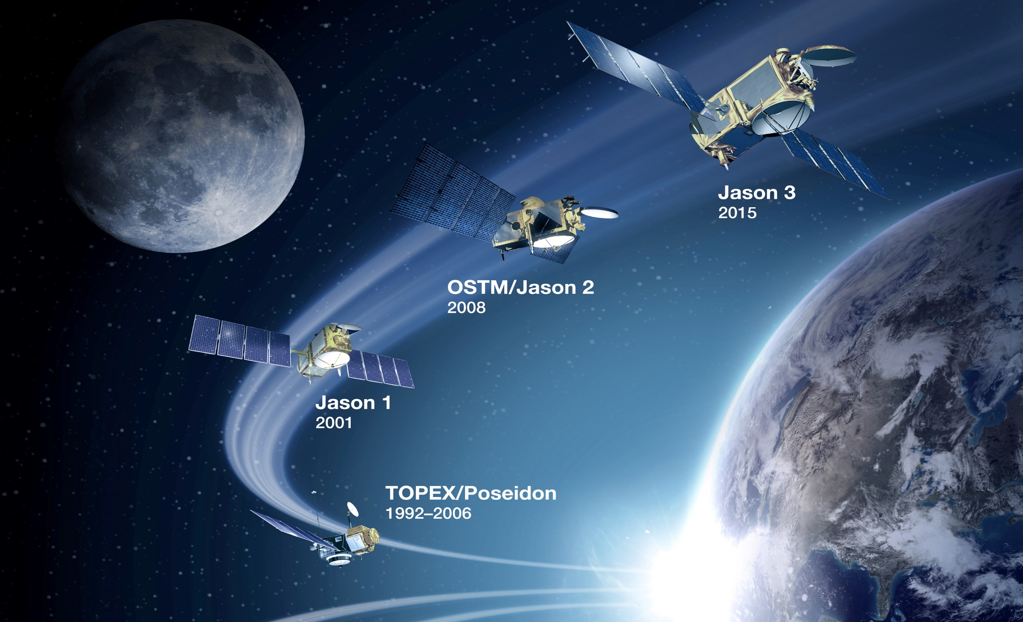
Future Ocean Altimetry Observations: Jason-3
Partnership with EUMETSAT, CNES, & NASA
Launch date TBD
Notes:
We are looking forward to launching the next ocean altimetry mission, Jason-3, as soon as can be safely done. We will stay in close contact with our mission partners, EUMETSAT, CNES, and NASA, as we move forward.
Jason-2 continues to operate well and we recently completed an exchange of letters with the mission partners, to continue operating Jason-2 at least through the end of December 2017.

Slide 22
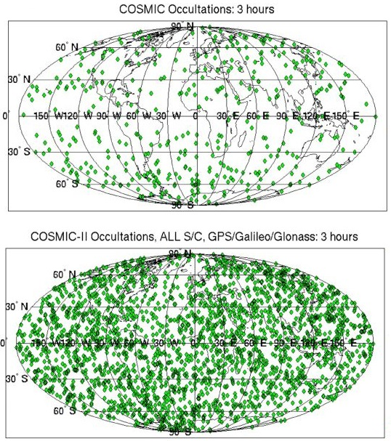
Future GNSS Radio Occultation: COSMIC-2
The Constellation Observing System for Meteorology, Ionosphere, and Climate, or COSMIC, mission is a Partnership with Taiwan, NASA, and the U.S. Air Force
Will provide global radio-occultation measurements of ionosphere, temperature and water vapor information to improve weather forecasts
Valuable data due to non-biased quality, accuracy and depth
Shown here is a comparison of sounding distribution over three hour periods between COSMIC and fully-implemented COSMIC-2 (12 satellites)
Launch in 2016 of the first set of six COSMIC-2 satellites
Notes:
COSMIC-2
The first 6 COSMIC-2 satellites (focused on equatorial regions) are scheduled for launch in 2016. The second 6 (expanded to mid-latitudes and polar regions) in FY18—the spacecraft are not yet funded.
Work by NASA, U.S. Air Force, and Taiwan to develop the first 6 satellites in the COSMIC-2 constellation is ongoing.
The ground system will also have the capability of ingesting RO data from foreign and commercial satellites.
COSMIC-2 is a cost effective means of obtaining global atmospheric temperature profiles; data currently used to determine high accuracy atmospheric temperatures at various altitudes that improve weather forecasts. The value of the data, as measured through adjoint studies, remains in the top 5 of all available data due to its non-biased quality, accuracy and depth. COSMIC 2 data have even lower latency than COSMIC 1 data.
COSMIC data is the best quality data of the range of GPSRO available in terms of its non-biased quality, accuracy and depth that the temperature and moisture data can be retrieved into the boundary layer compared to other GPSRO data.
COSMIC data helps make the radiance data from other satellites better by removing warm biases and also helps reduce the warm bias of aircraft data
COSMIC 2 data will be even better than COSMIC 1 data with lower latency. Still will feature all weather, day and night, no bias or drift
Image: A comparison of sounding distribution over three hour periods between COSMIC and fully-implemented COSMIC-2. 8000-12,000 profiles per day using GPS and GALILEO sources. Average profile within 45 minutes. Full vertical profile—deeper into lower troposphere.

Slide 23
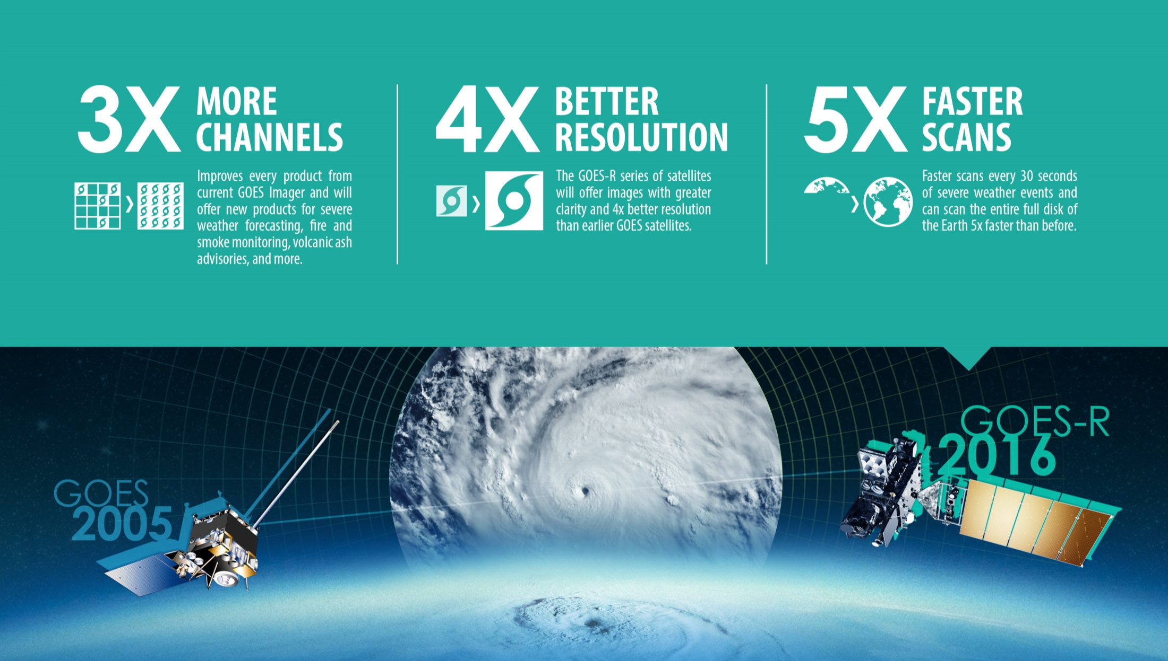
Future Geostationary Observations: GOES-R
Notes:
The next generation of NOAA satellites will showcase vast technological improvements.
GOES-R will provide images of weather pattern and severe storms as frequently as every 30 seconds, which will contribute to more accurate and reliable weather forecasts and severe weather outlooks.
3X more channels - improves every product from current GOES imager and will offer new products for severe weather forecasting, fire and smoke monitoring, volcanic ash advisories and more.
4X better resolution - GOES-R will offer images with greater clarity
5X faster scans – GOES-R will provide images of weather pattern and severe storms as frequently as every 30 seconds, and can scan the entire full disk of the Earth 5x faster than before

Slide 24
Future Geostationary Observations: GOES-R
March 2016 launch date postponed to Fall 2016
NOAA, NASA, and Lockheed Martin have identified schedule risks that have impacted the current launch date for GOES-R.
After extensive review, NOAA decided it can best avoid these risks to the mission by moving the launch date from March 2016 and to pursue a potential launch slot in the fall 2016.
Revised GOES-R satellite delivery schedule will be available in October-November 2015.

Slide 25
Future Geostationary Observations: GOES-R Advanced Baseline Imager
ABI Current
GOES-N to P
5 bands
Approx. 1 km n/a
Approx. 4 km
Spectral Coverage
Spatial resolution
0.64 μm Visible Other Visible/near-IR Bands (>2 μm)
Spatial coverage
16 bands
0.5 km
1.0 km 2 km
Full disk | 4 per hour | Scheduled (3 hrly)
CONUS | 12 per hour | ~4 per hour
Mesoscale | Every 30 sec | n/a
Visible (reflective bands)
On-orbit calibration
Yes
No

Slide 26
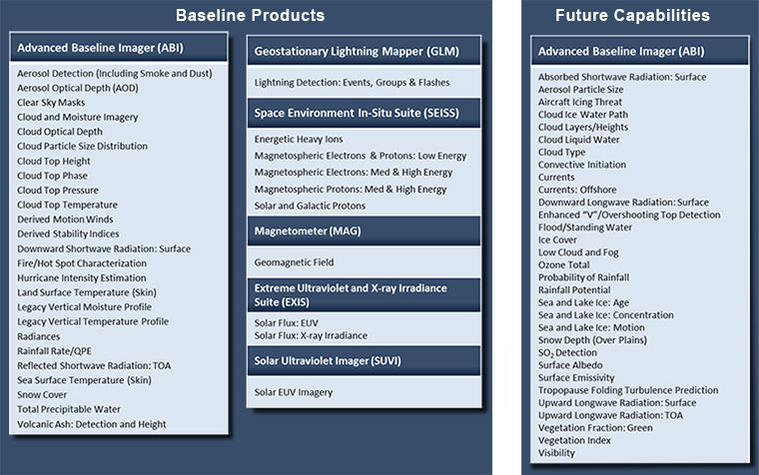
Future Geostationary Observations: GOES-R Planned Products

Slide 27
Future Geostationary Observations: GOES-R Data Distribution
GRB
Direct Broadcast Community
Sectorized Cloud and Moisture Imagery
Fastest
AWIPS NCFs
AWIPS NCFs
NOAAPort Community
NOAA
Port
L1B and L2+ Derived Products
Instrument Data
Access Speed
GRB
GOES-R GS
PDA
NSOF
Operational User Community
(NOAA Centers, DOD, NCEP, Int’l Partners)
WCDAS
Slowest
GOES-R GS
RBU
Climate Research
& Academia
L1B and L2+ Derived Products

Slide 28
Future Geostationary Observations: Himawari Project
JMA and NOAA/NESDIS collaborated on testing and establishing a connection to HimawariCloud service for the access of H-8 HSD level 1b to support NOAA users.
NESDIS Center for Satellite Applications and Research (STAR) is hosting the IOC (including Data Ingest, Data Processing and Product Generation, and Data Distribution).
Full H-8 16 channel AHI data distribution from the STAR server began in April 2015. This configuration will be in effect until the activation of the PDA in summer 2016.
SINET and Internet pathways are being used to access H-8 data from JMA’s HimwariCloud service.
H-8 data from STAR’s server is provided on a best effort basis to NWS JCSDA, NWS AWIPS II, and DoD.
Future Data Processing and Product Generation
NESDIS is currently assessing alternatives for the operational data processing and product generation system at the NSOF.

Slide 29
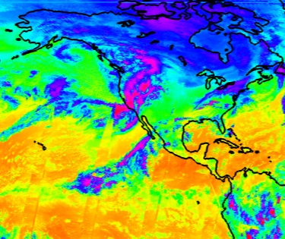
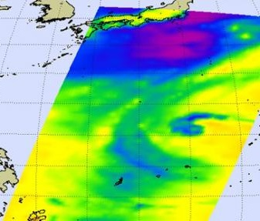
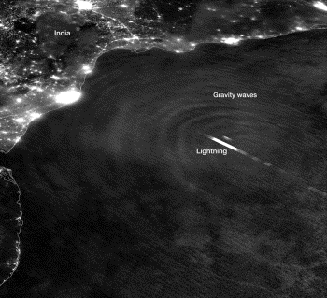
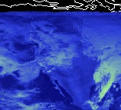
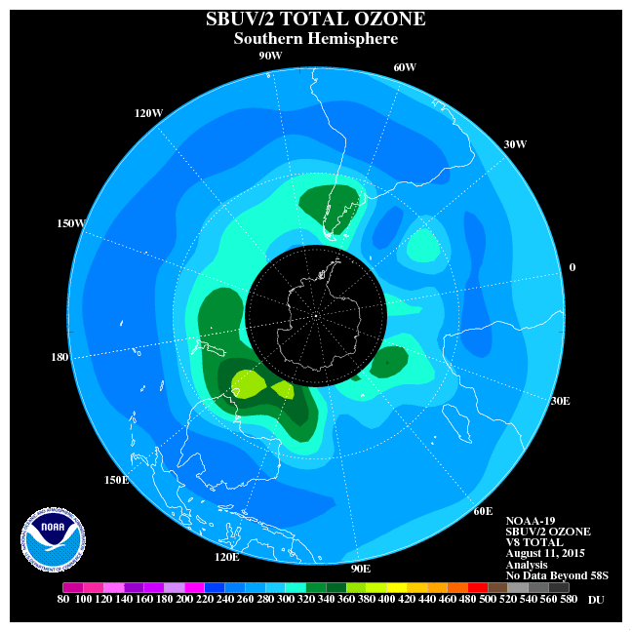
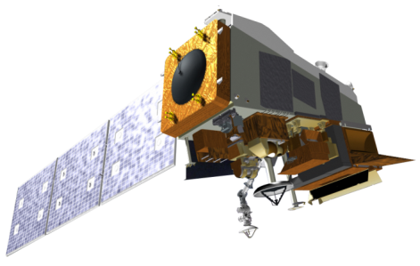
Future Polar-Orbiting Observations: JPSS
CrIS
ATMS
VIIRS
CERES
OMPS
JPSS
2017
Notes:
For a little more than a year now – and nearly 7,000 orbits – Suomi NPP has been our primary polar orbiting mission giving us a view of what JPSS will bring. JPSS will provide the most critical data for numerical weather prediction to enable accurate 3-7 day ahead forecasts; operational weather and environment satellite observations for Alaska and Polar Regions operational forecasting; and global coverage and unique day and night imaging capabilities.
JPSS: CrIS, ATMS and VIIRS, along with the OMPS, CERES instruments all show significant improvements in data collection over their legacy instruments.
Data/Data Distribution
With these instruments comes an increase in data—multiple terabytes daily. NOAA is working towards enterprise solutions beginning with common (enterprise) data distribution
The NOAA Data Extrapolation (NDE) project, which has been performing efficiently and reliably delivering and distribution real time Suomi-NPP data since September 2013.
(Note: VIIRS nighttime image of March 2015 blizzard)

Slide 30
Future Polar-Orbiting Observations:
JPSS Instruments |  | Measurements & Products | Contractor
 | ATMS - Advanced Technology Microwave Sounder | High vertical resolution temperature and water vapor information critical for forecasting extreme weather events, 5 to 7 days in advance | Northrup Grumman Electronic Systems
 | CrIS - Cross-track Infrared Sounder |  | Exelis
 | VIIRS – Visible Infrared Imaging Radiometer Suite | Critical imagery products, including snow/ice cover, clouds, fog, aerosols, fire, smoke plumes, vegetation health, phytoplankton abundance/chlorophyll | Raytheon Space and Airborne Systems
 | OMPS - Ozone Mapping and Profiler Suite | Ozone spectrometers for monitoring ozone hole and recovery of stratospheric ozone and for UV index forecasts | Ball Aerospace and Technologies Corp.
 | CERES – Clouds and the Earth’s Radiant Energy System (S-NPP and JPSS-1) RBI – Radiation Budget Instrument (JPSS-2, 3, 4; provided by NASA) | Scanning radiometer which supports studies of Earth Radiation Budget (ERB) | CERES - Northrup Grumman Aerospace Systems RBI - Exelis
Notes:
For a little more than a year now – and nearly 7,000 orbits – Suomi NPP has been our primary polar orbiting mission giving us a view of what JPSS will bring. JPSS will provide the most critical data for numerical weather prediction to enable accurate 3-7 day ahead forecasts; operational weather and environment satellite observations for Alaska and Polar Regions operational forecasting; and global coverage and unique day and night imaging capabilities.
JPSS: CrIS, ATMS and VIIRS, along with the OMPS, CERES instruments all show significant improvements in data collection over their legacy instruments.
Data/Data Distribution
With these instruments comes an increase in data—multiple terabytes daily. NOAA is working towards enterprise solutions beginning with common (enterprise) data distribution
The NOAA Data Extrapolation (NDE) project, which has been performing efficiently and reliably delivering and distribution real time Suomi-NPP data since September 2013.
(Note: VIIRS nighttime image of March 2015 blizzard)

Slide 31
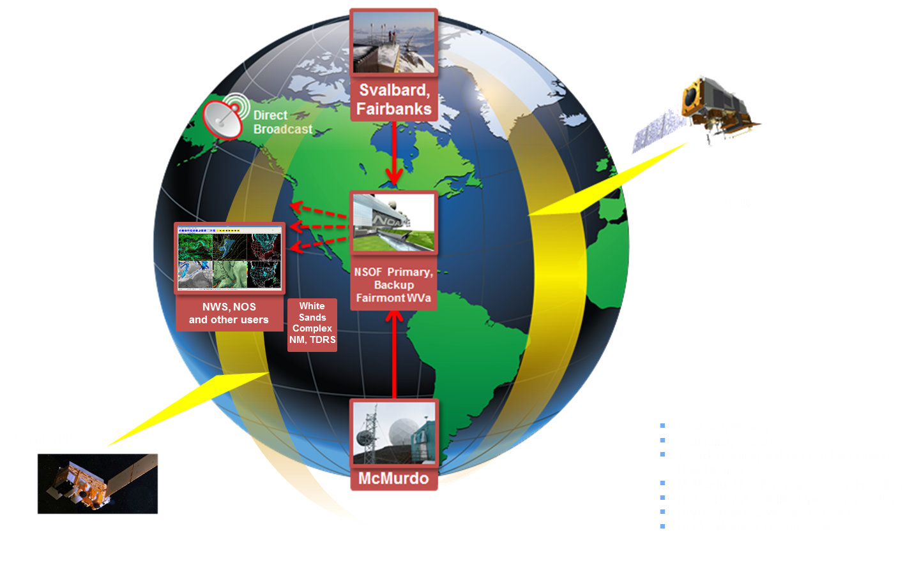
Future Polar-Orbiting Observations: JPSS System Architecture

Slide 32
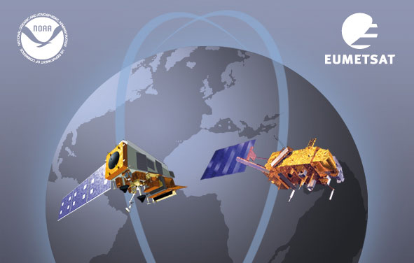
NOAA-EUMETSAT Joint Polar System Agreement
Governs JPSS-2, Polar Follow-On, and Metop-Second Generation
Secures critical partnership for global NWP through the 2030s
Notes:
NOAA is looking forward to concluding the Joint Polar System agreement with EUMETSAT later this year.

Slide 33
Future Data Distribution:
PDA Overview
The Production Distribution and Access (PDA) system will serve as the NESDIS enterprise distribution system for our near real-time users.
PDA will set subscriptions for international and non-US government partners, as is done now on the DDS.
All near real time distribution except for McIDAS will be migrated to PDA – phased approach (new missions and then current missions).
McIDAS ADDE access will remain on GEODIST systems for the foreseeable future.
GOES-R products will be provided to the primary PDA system (at NSOF)
S-NPP/JPSS products will be provided via IDPS and PDA
All distribution will use FTPS or SFTP protocols

Slide 34
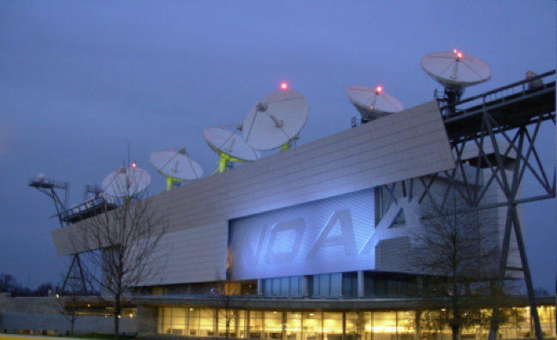
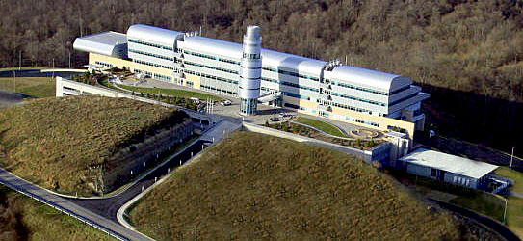
Future Data Distribution:
PDA Overview
Smaller capacity operational contingency system at Consolidated Back-Up (Fairmont, West Virginia)
S-NPP/JPSS data only (just the prime mission sensor)
GOES-R data only available via GRB (GOES Re-Broadcast) and AWIPS
There are three PDA Systems:
Full Operational System at NSOF
S-NPP/JPSS, GOES-R and current mission data
Test system at NSOF
Internal test system only and just a few select users with periodic access

Slide 35
Future Data Distribution:
PDA Schedule
Internal readiness reviews:
Operational Readiness Review (ORR) scheduled for Summer 2016
Actual near real-time data flow is dependent upon the new JPSS ground system upgrade (Spring 2016)
Existing users of S-NPP NDE system are being scheduled for integration.
Existing NESDIS ESPC DDS and NDE users with questions should contact:
Donna McNamara (Data Access Manager) donna.mcnamara@noaa.gov
Chris Sisko (JPSS Data Operations Manager) chris.a.sisko@noaa.gov
Matt Seybold (GOES-R Data Operations Manager) matthew.seybold@noaa.gov
New users with questions should contact:
NESDIS Satellite User Services NESDIS.Data.Access@noaa.gov

Slide 36
Thank you!

Slide 37
Backup

Slide 38
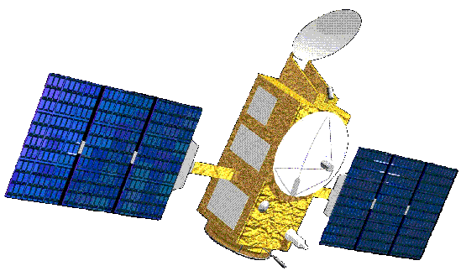
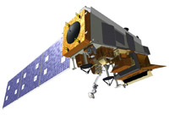
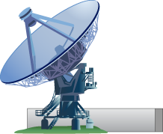
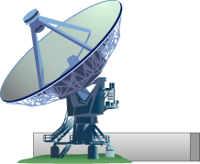
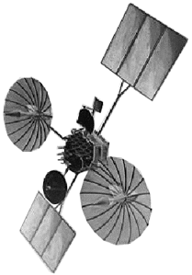
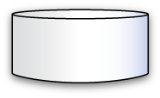
Data Distribution: Architecture
SNPP/JPSS-1 (PM)
POES NOAA-19
Center for Satellite Applications
and Research (STAR)
GOES-West
GOES-East
Non-NOAA
(Jason2, DMSP, Meteosat, MTSAT,
Metop, EOS, COSMIC, others)
Product Development
Algorithm Development
Science Maintenance
Office of Satellite and Product Operations (OSPO)
METOP-B/C (AM)
TDRSS
Fairbanks
Wallops
Svalbard
McMurdo / Troll
Command and Control
Processing and Distribution
Satellite Operations Control Center
Environmental Satellite Processing Center
Suitland
Customers
Office of Satellite Ground Services (OSGS)
Data and
Products
Ground Systems Development and Sustainment,
IT Enterprise Architecture
Archive and Access
NESDIS Data Centers

Slide 39
Refocusing Our Organization
Office of System Architecture & Advanced Planning
Next generation satellite systems planning
Office of Projects, Planning & Analysis
Increased focus on project execution
Office of Satellite Ground Services
Development lead for future integrated ground system
National Centers for Environmental Information
Consolidated environmental services
Notes:
We are making sure that our organization is positioned to succeed over the next decades, and to do that, we’ve reorganized some of our offices. These new/changed offices allow us to bring in some additional expertise and to realize organizational efficiencies. One example is the National Centers for Environmental Information, whose logo you see here – we’ve combined the executive functions of our three data centers (National Climatic Data Center, National Geophysical Data Center, National Oceanographic Data Center) into NCEI.

Slide 40
DMSP Constellation Status
Flight Number | F-14 |  | F-15 |  | F-16 |  | F-17 |  | F-18 |  | F-19
Operations Number | 48 |  | 49 |  | 54 |  | 51 |  | 53 |  | 52
LTAN (+/- 5 Mins) | 1552 |  | 1442 |  | 1621 |  | 1813 |  | 1925 |  | 1836
Launch Date | 4/4/1997 |  | 12/12/1999 |  | 10/18/2003 |  | 11/4/2006 |  | 10/18/2009 |  | 4/3/2014
Spacecraft Subsystems [Bus]
Command & Control
Power
Attitude Control
Communications
Strategic Mission [Primary sensors & recorders]
Visible/IR Imager (OLS)
Individual Recorder Status | 1 | 2 | 1 | 2* | 1* | 2* | 1* | 2* | 1* | 2* | 1* | 2*
 | 3 | 4 | 3 | 4* | 3* | 4* | 3* | 4* | 3* | 4* | 3* | 4*
Microwave Imager/Sounder (SSMI/SSMIS)
Microwave Temp Sounder(SSMT1)
Microwave Water Vapor Sounder(SSMT2)
Tactical Mission [Spacecraft transmitters]
Transmitter Status | DDT | PDT1 | DDT | PDT1 | DDT | PDT1 | DDT | PDT1 | DDT | PDT1 | DDT | PDT1
 |  | PDT2 | RAD | PDT2 |  | PDT2 |  | PDT2 |  | PDT2 |  | PDT2
 | EDT1 | EDT2 | EDT1 | EDT2 | EDT1 | EDT2 | EDT1 | EDT2 | EDT1 | EDT2 | EDT1 | EDT2
Space Environment Mission [Secondary sensors]
X/Gamma Ray Detector(SSB-X family)
Magnetometer (SSM)
Ionosphere (SSI-ES2/-ES3)
Electron/Proton (SSJ4/SSJ5)
UV Limb Imager (SSULI)
UV Spectrographic Imager (SSUSI)
CAO: 21 August 15
* Denotes Solid State Recorder (SSR) POC: 50 OG/DET 1 Watch Officer (301-512-8479)

Slide 41
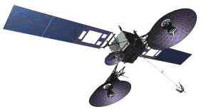
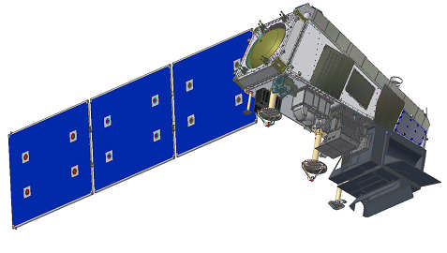
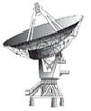
Current Polar-Orbiting Observations: Suomi NPP S/C Communication Links
TDRS
CMD: 2067.270833 MHz
125& 1000 bps
TLM: 2247.5MHz
1.024, 4.096 or16.384 kbps
(Realtime Only)
SMD
Antenna
DB
Antenna
S-Band
Antenna
CMD2067.270833 MHz
2,000 & 128,000bps
TLM2247.5MHz
1.024, 4.096, 16.384,
32.768 kbps (Realtime)
524.288 kbps (Stored)
8.2125GHz
300.0Mbps
7.812 GHz
15 Mbps
TDRSS
Ground Link
TDRSS
White Sands Station
Direct Broadcast Downlink
Direct Readout User Terminal
Svalbard,Norway Station

Slide 42
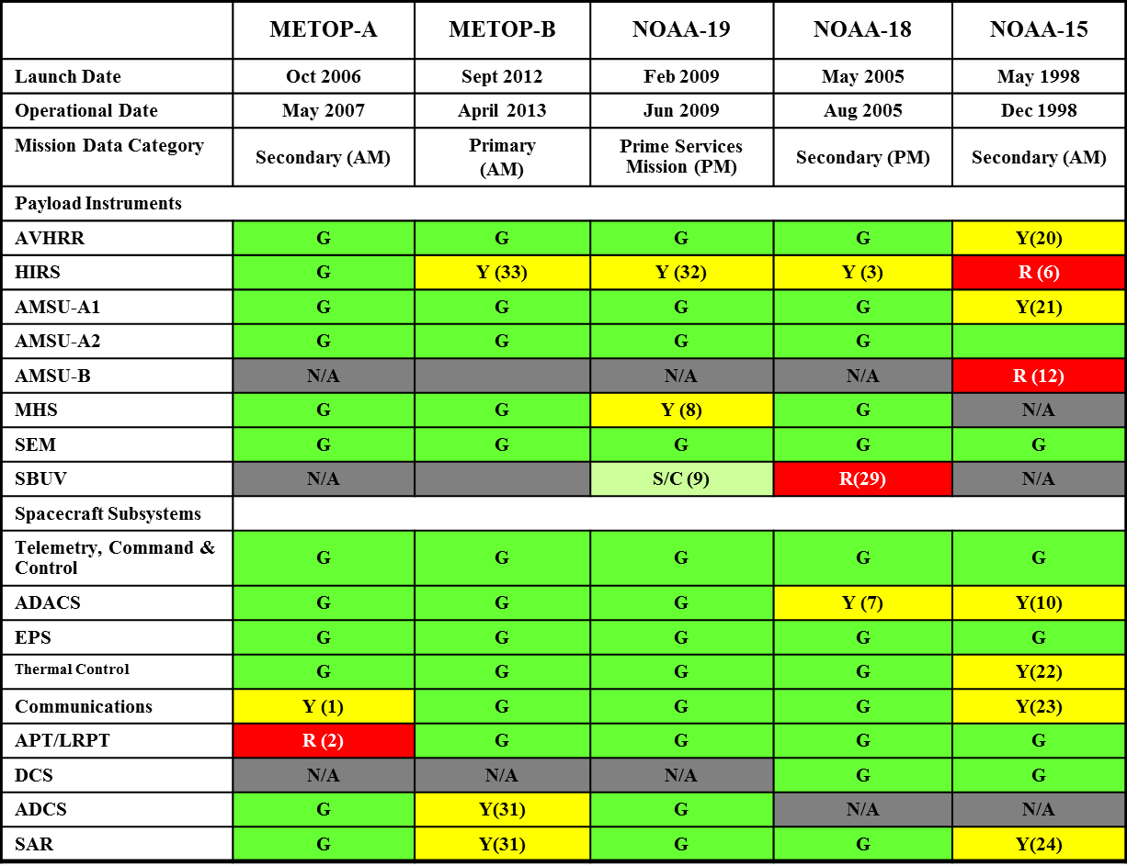
Current Polar-Orbiting Observations: Instrument Status
HIRS Long Wave Channels 5, 6, soon to be out of spec. Ch 10 out of spec.
HIRS Long Wave Channel noise increased.
HIRS filter wheel stalled. No impact . METOP-A used.
HIRS long wave channel noise. Inconsistent quality of IR channels.
AMSU-B antenna scan motor failed. No products available. METOP-A used.
MHS H3 operating dynamic ranges decreased. Out of spec.
Chopper motor stalled. No usable data generated.
NO LRPT data available. Transmitter off.
ADCS/SAR RF Loss of ~10dB. Limited coverage w/ ~35% less availability for data collection
STX1 & 3 failed, STX2 HRPT, STX4 PB. Limited amount of data retrieved per pass.

Slide 43
Environmental Information
Maximize the Return on Investment of the Nation’s Earth Observing Satellites Systems
National
Climatic Data Center
National Ocean Data Center
National Geophysical Data Center
Ensure a high scientific quality satellite data stream
Develop science to maximize the utilization of the different satellite data
Analyze and interpret data for decision making purposes
https://www.ncei.noaa.gov/
Notes:
We are looking at ways to improve our product development and distribution.
Recently, we integrated the three National Data Centers into the new National Center for Environmental Information - NCEI – structure.
By using consistent data stewardship tools and practices across all science disciplines and by forging an improved data management team, users will see an improvement in the overall value of our environmental data archives.
The transition to NCEI will take time, with the final integration anticipated beyond 2020.
An overriding principle throughout the formation of NCEI is transparency to our users and commitment to continuing to provide the geophysical, oceans, coastal, weather and climate data users have come to rely on.
In addition, we are working to integrate STAR and the Centers with the rest of NESDIS for product development and distribution.
We are also exploring some non-traditional models for distributing our data.

